Slide 1
Netflix 2017 Stock
Mahmoud Shihab – Stock Profile Team Data Scientist

Slide 2
List of Visualizations
Netflix: 2017 cost distribution per quarter
Netflix: Actual vs Estimated Earnings per Share per Quarter
Netflix: Earnings vs. Revenue
Netflix Vs. Dow Jones

Slide 3
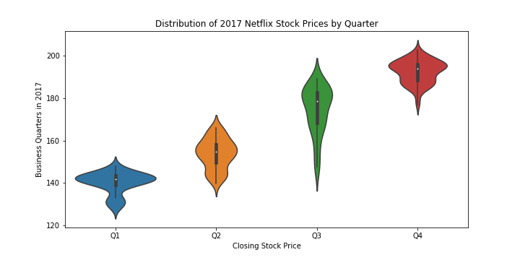
Netflix: 2017 Cost Distribution by Quarter
Prices have constant increasing trend throughout the year.
The length of violin plot suggests there was a dip in Q3.
The Q3 shape suggests that despite the variation, the majority of the distribution fits the increasing trend
The distribution per quarter is very top heavy.

Slide 4
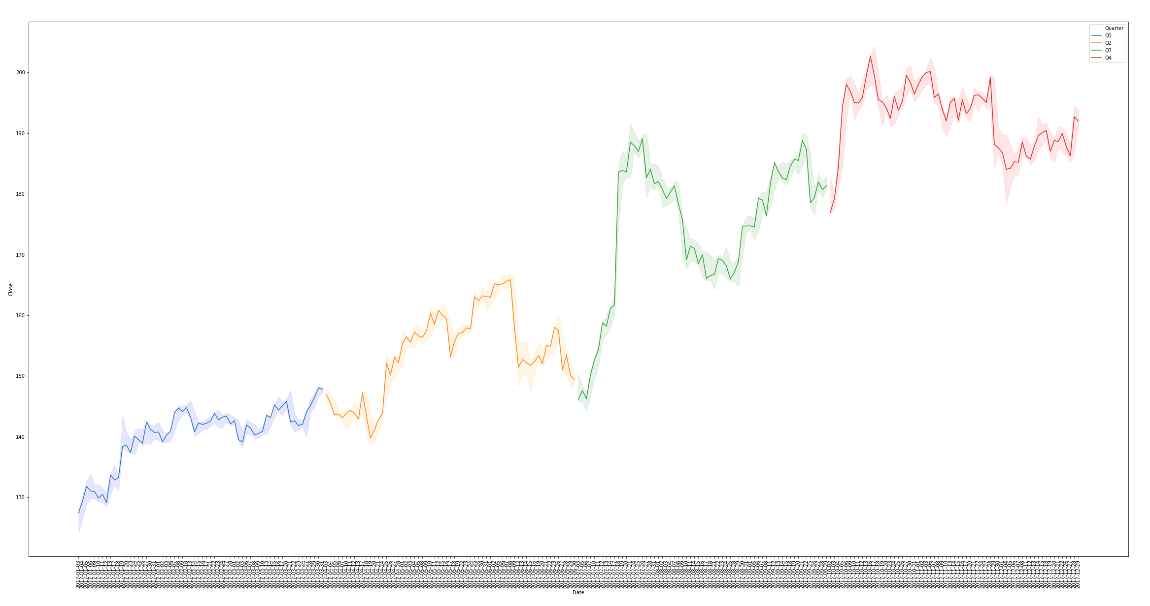
Netflix: Daily Close Price per quarter

Slide 5
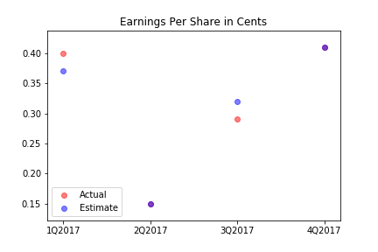
Netflix: Actual vs Estimated Earnings per Share per Quarter
2Q2017 and 4Q2017 both had actuals equal to their estimates
2Q2017 was far lower than the rest of the year
4Q2017 was the highest year for both actual and estimates
1Q2017 actual exceeded estimate
3Q2017 actual was below estimate

Slide 6
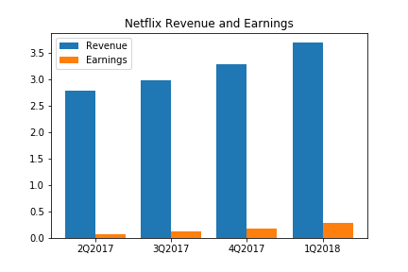
Netflix: 2017 Revenue and Earnings
Netflix makes a lot of money, but their expenses are more than 90% of those sales.
The increase of Revenue and Earnings per year suggests that Netflix continually succeeds and make more increasing profits per quarter

Slide 7
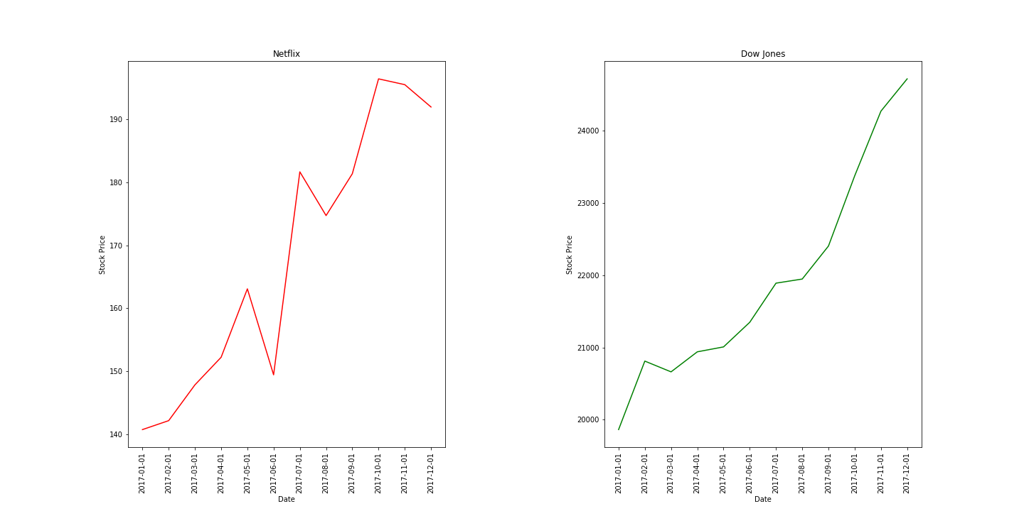
Netflix Stocks vs Dow Jones Stocks

